Slide 1
Ethereum Documentation

Slide 2
About Ethereum
Runs on blockchain technology for decentralized applications.
Repurposed the blockchain for building a trustless smart contract platform

Slide 3
Ethereum Virtual Machine
Allows users to create their own operations (such as creating contracts, independent voting mechanisms etc.)
Solidity is modelled on existing languages like JavaScript and Python
EVM converts code of arbitrary algorithmic complexity into bytecode for execution
Uses a P2P protocol for blockchain to be maintained and updated.
Notes:
P2P: Peer 2 peer, also to maintain consensus throughout entire blockchain.
This p2p protocol allows for fault tolerance, zero downtime, and makes data unchangeable and censorship-resistant.

Slide 4
Accounts
2 types of accounts
Externally Owned Accounts (EOAs)
Controlled by private keys, such as wallets
Contract Accounts
Controlled by their contract code, such as purchasing tokens

Slide 5
Externally Owned Accounts (EOAs)
Controlled by keyfile and a password
The keyfile contains both the private and public key. The private key is encrypted with the user-defined password.

Slide 6
Transactions
Users must pay transaction fees to the network (computed by amount of gas), this protects the blockchain from attacks or infinite loops.
Miners rewarded with ether for each successful block mined. (5 ether)
Miners are required to solve a complex mathematical problem (in the form of a hash), otherwise known as “Proof-of-Work” (PoW).
Ethereum uses memory-hard computational algorithms (Ethash) to prevent use of specialized hardware (like ASIC).

Slide 7
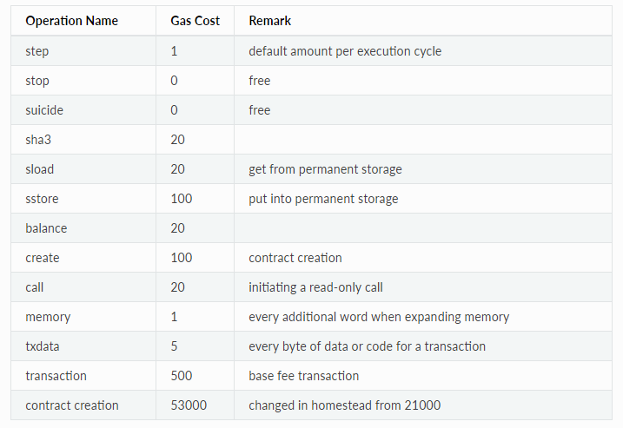
Commonly used transactions
Geth will automatically calculate the estimated gas cost

Slide 8
Obtaining ether
Mining
Trade currencies (either from physical money or other cryptocurrencies such as Bitcoin)

Slide 9
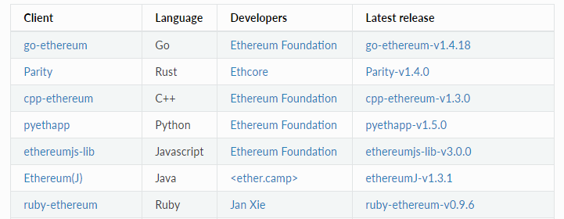
Clients

Slide 10
Clients
General users will usually install Mist/Wallet as a AIO solution.
Notes:
AIO: All-in-One

Slide 11
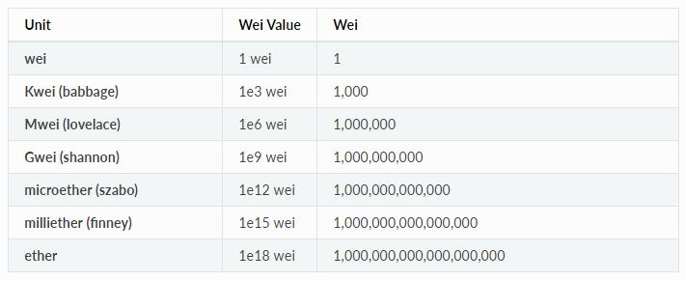
Currency
Base unit of Ethereum is wei

Slide 12
Geth
Private blockchains can easily be setup by creating a json file with details on the intended genesis block details and attaching a miner to it [2]
Geth can also connect to Testnet (Morden) for users to test out their code before deploying on Mainnet (Homestead). (This can be done by adding the option --testnet when running geth)

Slide 13
References
http://www.ethdocs.org/
https://medium.com/blockchain-education-network/use-geth-to-setup-your-own-private-ethereum-blockchain-86f1200e6d40

